Slide 1
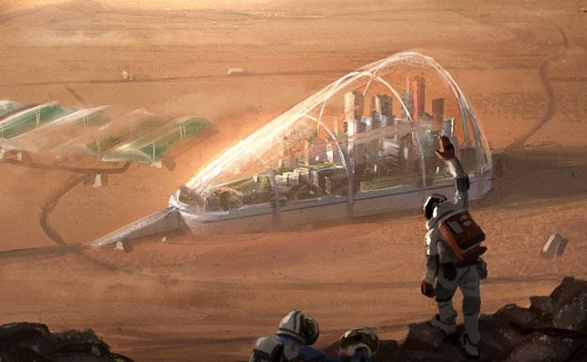

Transcendence 2017
Colonization of mars
Presenter: Ashwin Sivakumar

Slide 2
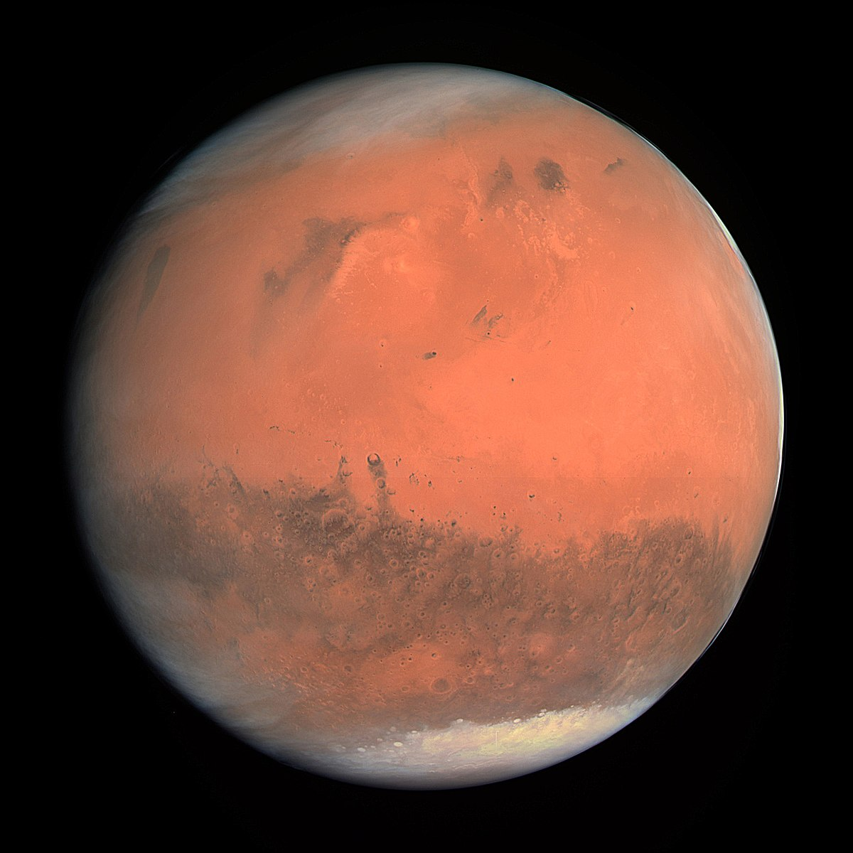
Mars is the 4th planet from the sun and the second smallest in the solar system
Has 2 natural satellites: Phobos and Deimos
Known as red planet
INTRODUCTION TO MARS

Slide 3
Christian Huygens discovered mars
NASA’s curiosity rover lands on the Gale crater on Mars.
SpaceX CEO Elon Musk unveils plans to send people to mars by 2022
1659
1971
2012
2014
2017
Mariner 9 becomes the first artificial satellite to orbit around mars.
Mars Orbiter Mission is the first Indian satellite to orbit mars.
TIMELINE OF ACTIVITIES ON MARS

Slide 4
Ensuring the survival of our species
2. Discovering life on mars
3. Improving the life on earth
4.Growing as a species
5. Political and economic leadership
Why Colonize Mars?

Slide 5
SpaceX is planning for a Manned Mars landing by 2022
Mars One is planning for a permanent mars colonization by 2032
US government is planning for a non colonizing return trip in the 2030s
Russian Government is planning for non colonizing return trip by the year 2030
Plans for Colonization by space organizations
https://en.wikipedia.org/wiki/Colonization_of_Mars

Slide 6
A Solar day in mars is 24 hours and 39 minutes.
Mars has a slightly smaller surface area compared to the earth
Mars has seasons similar to the earth
Recent observations of NASA Mars Reconnaissance Orbiter, ESA’s Mars Express, and NASA Phoenix Lander have confirmed the presence of water on mars
Similarities of mars to earth
https://en.wikipedia.org/wiki/Colonization_of_Mars

Slide 7

Plant and animals generally cannot survive on mars due to its extreme conditions.
The presence of microgravity has a possibility of causing muscle loss and bone demineralization
Mars is much colder than the earth with mean temperatures from -87 $℃$ to -5$℃$
Water on mars only occurs under certain conditions
Mars is 52% farther from the earth resulting in the lack of sunlight
Cosmic rays are likely to enter the Martian surface easily
The thin atmosphere does not filter out ultraviolet sunlight
Carbon Dioxide content is 95% while oxygen content is only 0.4%, This can lead to hypercapnia which is the poisoning due to carbon dioxide.
Dissimilarities of mars to earth
https://en.wikipedia.org/wiki/Colonization_of_Mars

Slide 8
Difference in gravity will result in the weakening bones and Muscles
the thin atmosphere is likely to cause cancer
The crew on the journey to mars will be isolated from the rest of humanity for around 2 ½ years which is likely to affect psychological health, the 2 way communication from the earth to mars is 44 minutes
Osteoporosis and Cardiovascular diseases is likely to be caused.
As said, the poisoning due to Carbon Dioxide gas (Hypercapnia is likely to occur) .
Effect of human health on mars
https://en.wikipedia.org/wiki/Colonization_of_Mars

Slide 9
Habitats
Storage facilities
Shop workspaces
Resource extraction equipment
Equipment for energy production and energy storage
Food Production spaces and equipment
Propellant production requirement – to produce methane and hydrogen using Sabatier Reaction
Communication equipment
Fuels or other energy source for use with surface transportation
Equipment required for colonization
https://en.wikipedia.org/wiki/Colonization_of_Mars

Slide 10
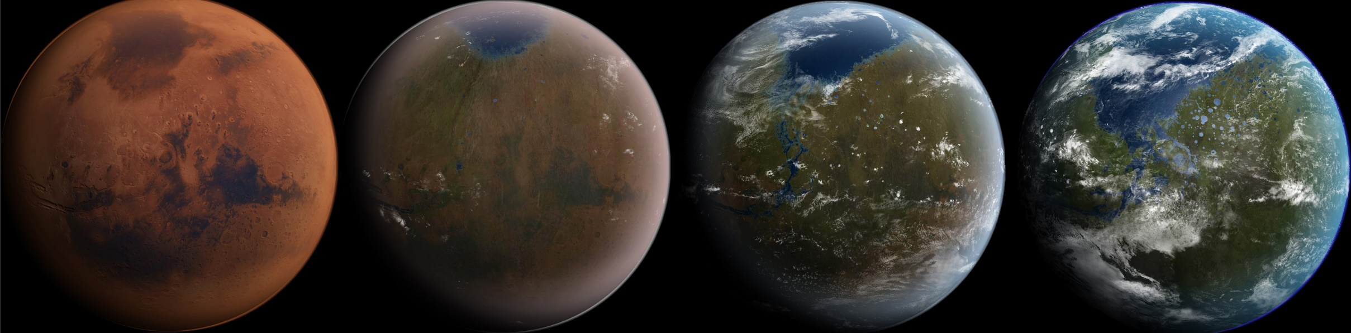
Terraforming of mars is the process of transforming the Martian climate habitable by us
Artist’s Conception on Stages of Terraforming
Terraforming
https://en.wikipedia.org/wiki/Terraforming_of_Mars

Slide 11
Importing Ammonia – to increase global warming
Importing Hydrocarbons – to act as the greenhouse effect
Using Fluorine Compounds
Use of Orbital Mirrors – to increase the amount of sunlight towards mars
Ecopoeisis – NASA and Techshot.inc are working together to produce cyanobacteria and algae for producing molecular oxygen. If this experiment works on mars, then they will propose to build large structures called biodomes to produce and harvest oxygen for the future generations.
Possible methods of Terraforming
https://en.wikipedia.org/wiki/Terraforming_of_Mars

Slide 12
SPAceX plans for colonizing mars

Slide 13
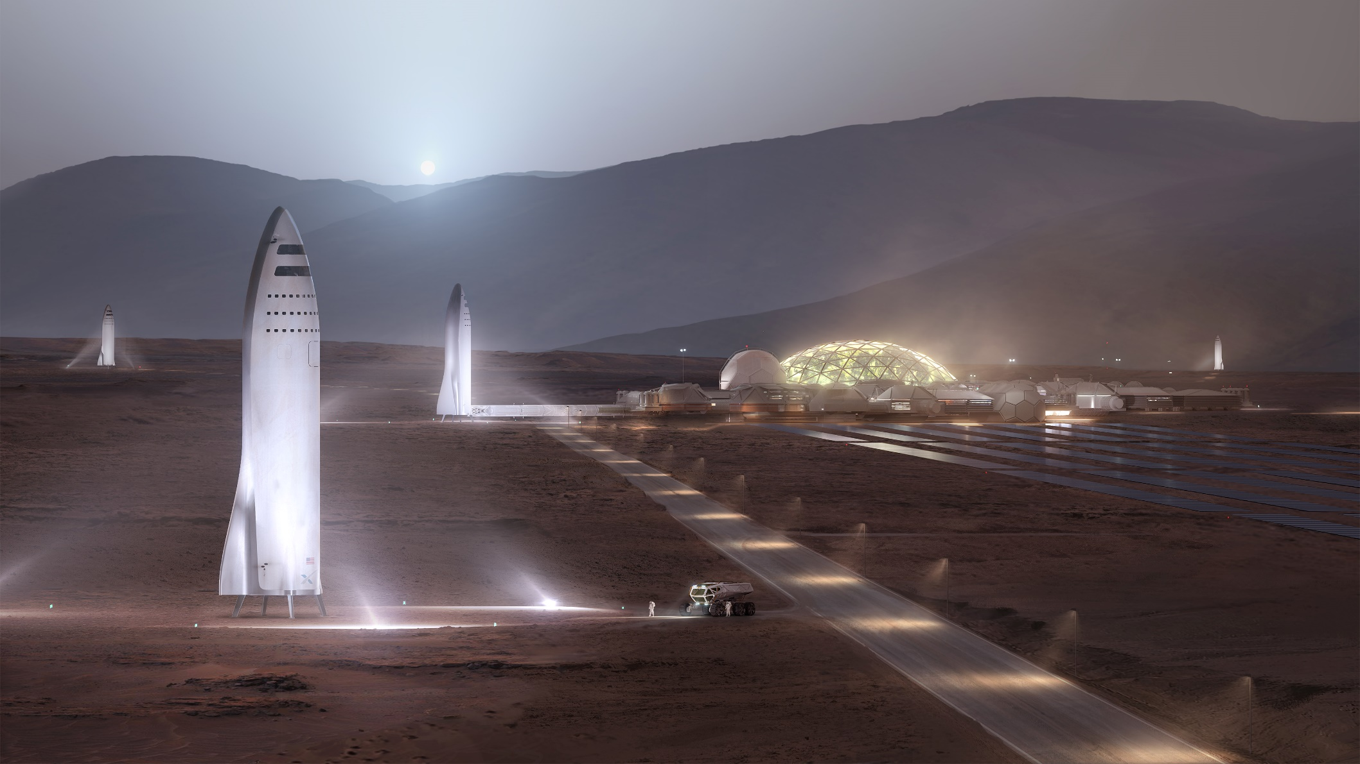

http://www.spacex.com/mars

Slide 14
The goal is to send a cargo mission to mars by 2022
The second mission which aims to send cargo and crew is scheduled for 2024 to build propellants and bases for future aircrafts
Further missions will be planned frequently over the course of time
http://www.spacex.com/mars

Slide 15
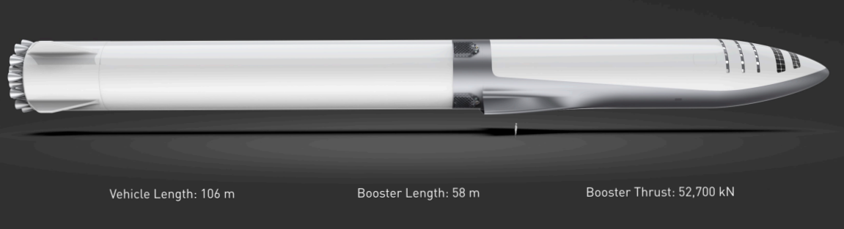
The Big Falcon Rocket was unveiled by SpaceX CEO Elon Musk, this will be the rocket of SpaceX which will be used in the mission to mars.
It is a privately funded reusable launch vehicle
Big Falcon Rocket by SpaceX

Slide 16
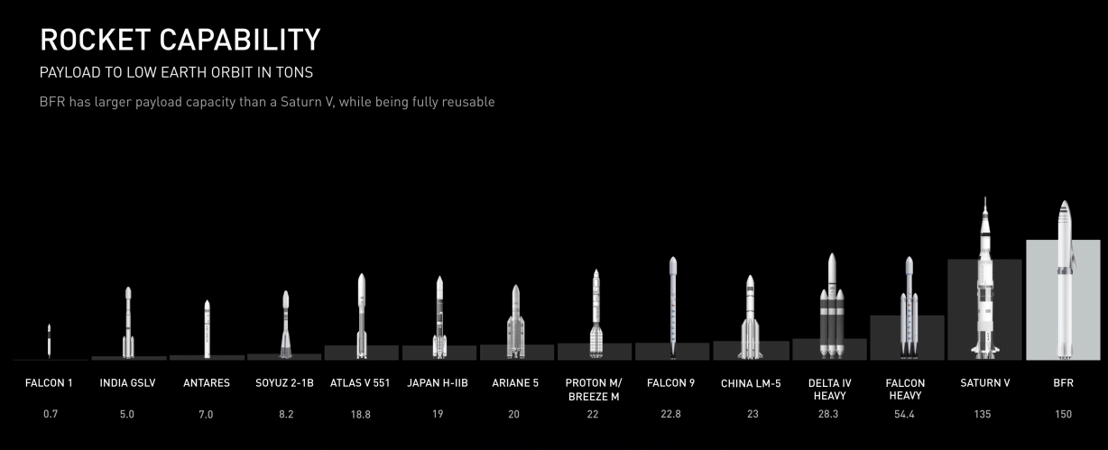

Slide 17
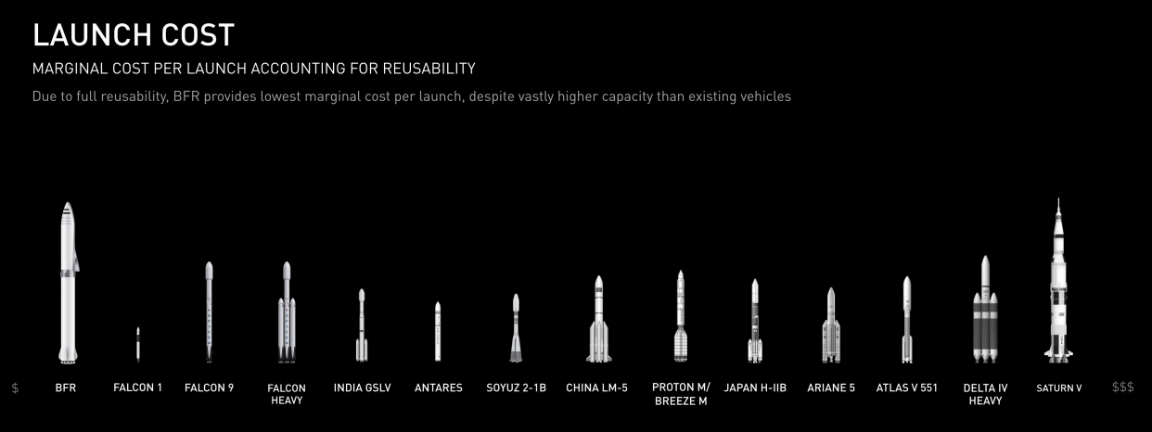

Slide 18
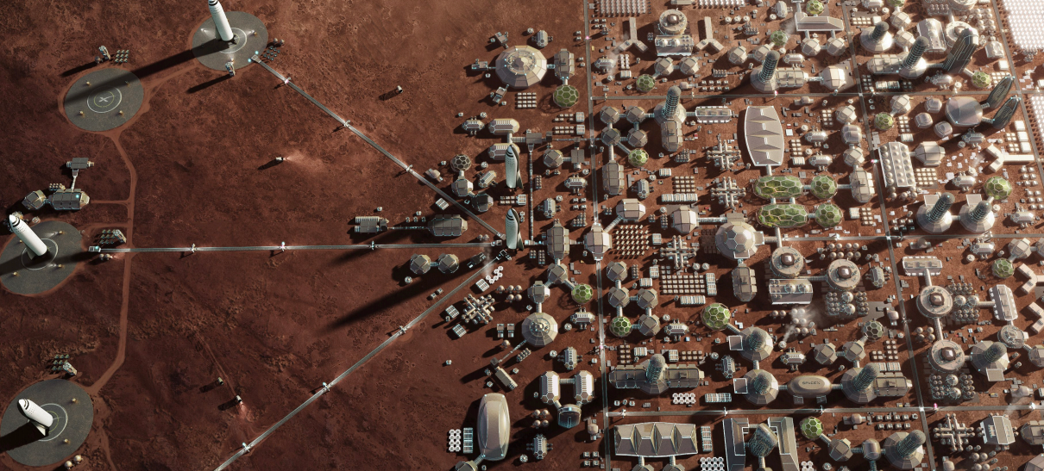
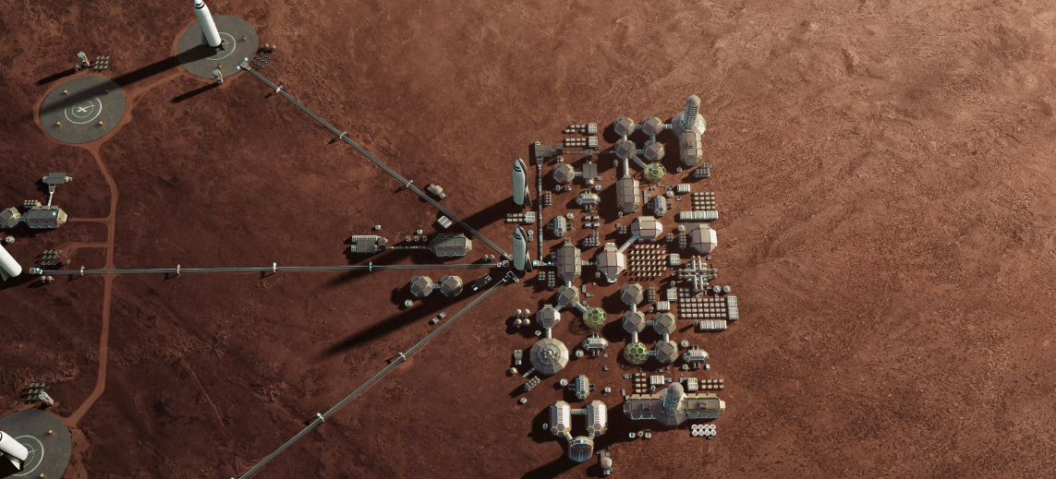
Stages of colonization of mars by SpaceX

Slide 19
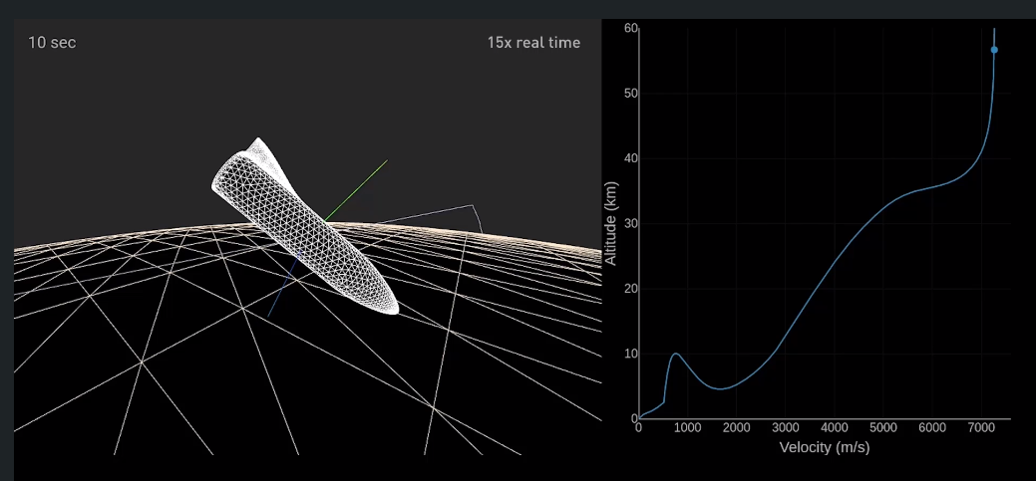
The BFR Rocket will enter the mars atmosphere at a velocity of 7.5 kilometers per second and decelerates aerodynamically
The heat shield can withstand entries to the Martian atmosphere. But the entry is so hot that there may be an wear and tear of the heat shield.
Possible Landing of the BFR rocket in mars

Slide 20
The Mission to mars will be possible in the future.
The current rocket mission can only send professional astronauts and wealthy aspirants who want to travel to mars.
With proper funding and research in the field of science and technology, we can get faster results of the same
By the 2070s there is a possibility when we can travel to mars at our own will
Conclusion

Slide 21
Thank You

